Slide 1
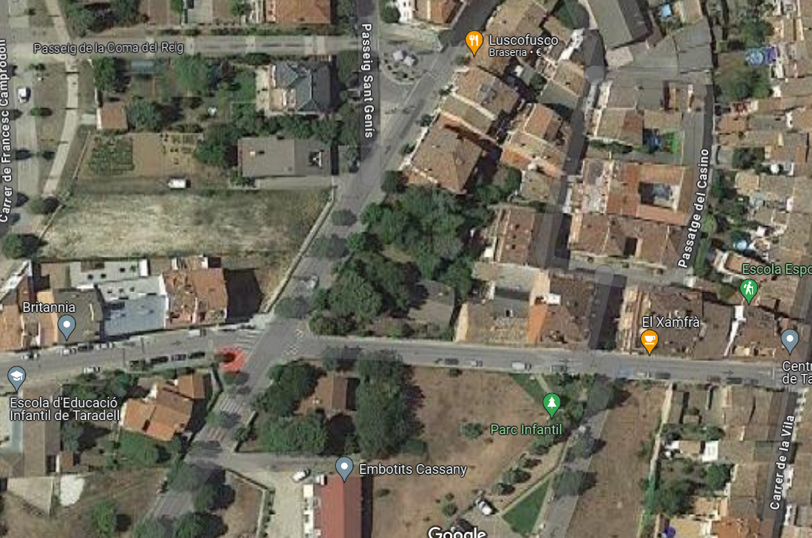
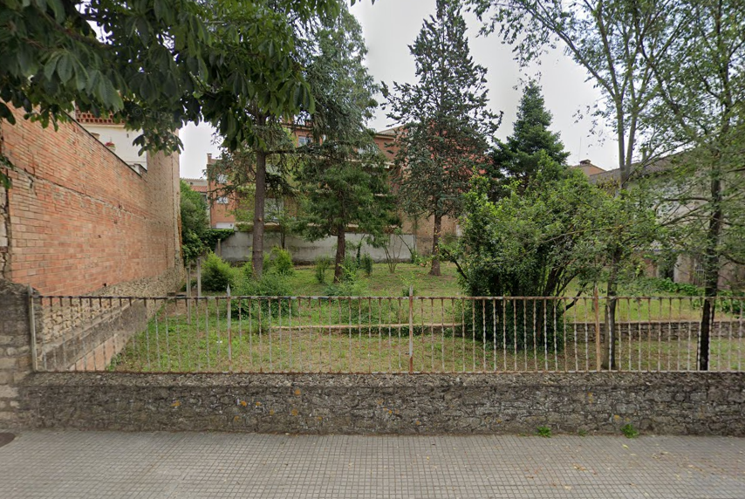
ANNEX II
Mesures del mur
16 metres
2,30 metres

